Slide 1
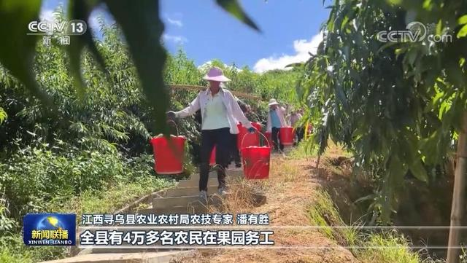
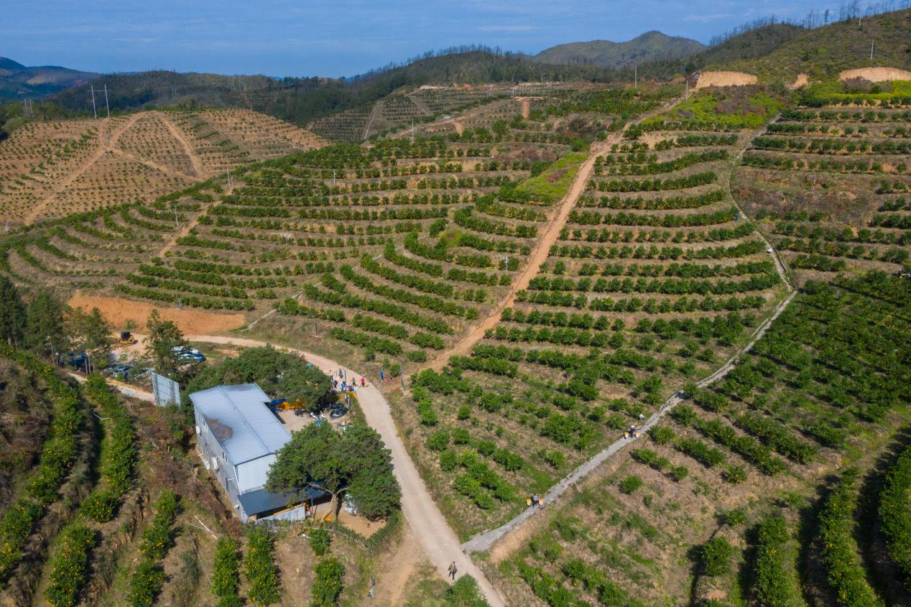
选题目的
中国脐橙之乡
中国蜜桔之乡
中国脐橙出口基地县
柑橘，是是橘、柑、橙、金柑，柚、枳等的总称，中国是柑橘物种最丰富且种植面积最大的国家之一，而江西省赣州市以其优越的自然条件和社会经济条件成为我国重要的蜜桔、脐橙生产基地，其中赣州寻乌县被称为“中国脐橙之乡”, 柑橘产量占赣南柑橘总量的三分之一，柑橘产业不仅是寻乌县国民经济发展的重要产业支柱，更是农民收入的主要来源之一。

Slide 3
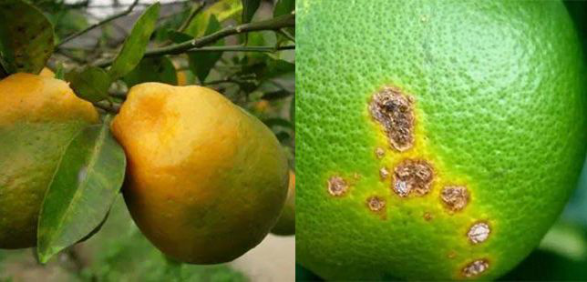
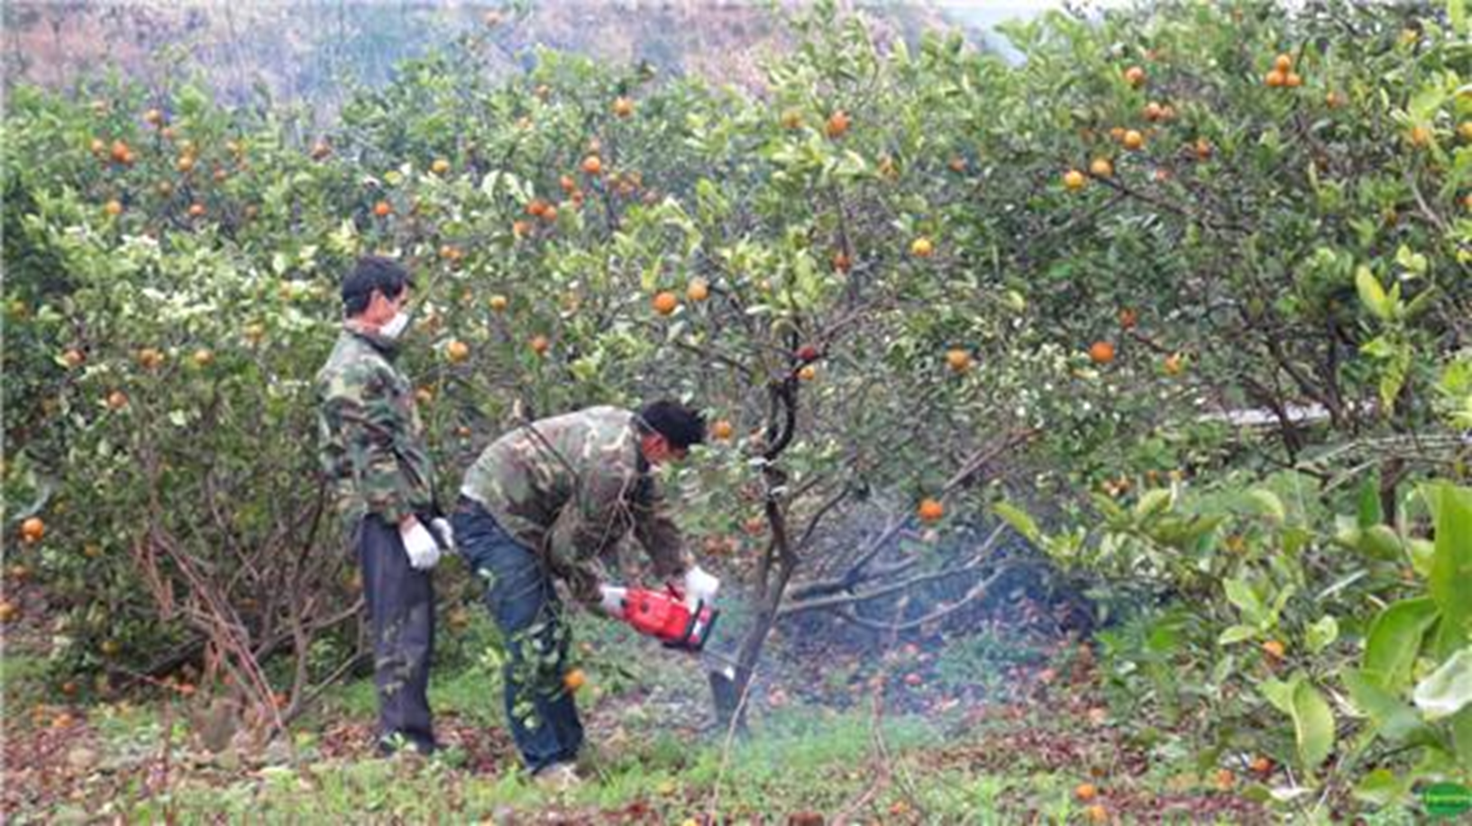
选题目的
柑橘果园极易受干旱、霜冻、病虫害的影响。2016年赣南地区柑橘黄龙病大规模爆发，大量果树遭到砍伐，给全县的果农造成了巨大的经济损失。
因此, 利用科学的方法准确地、动态地把握柑橘果园受灾后面积变化的动态过程，探究其变化的原因，对寻乌县乃至整个赣南地区柑橘种植以及黄龙病的防治都具有重要意义。

Slide 4
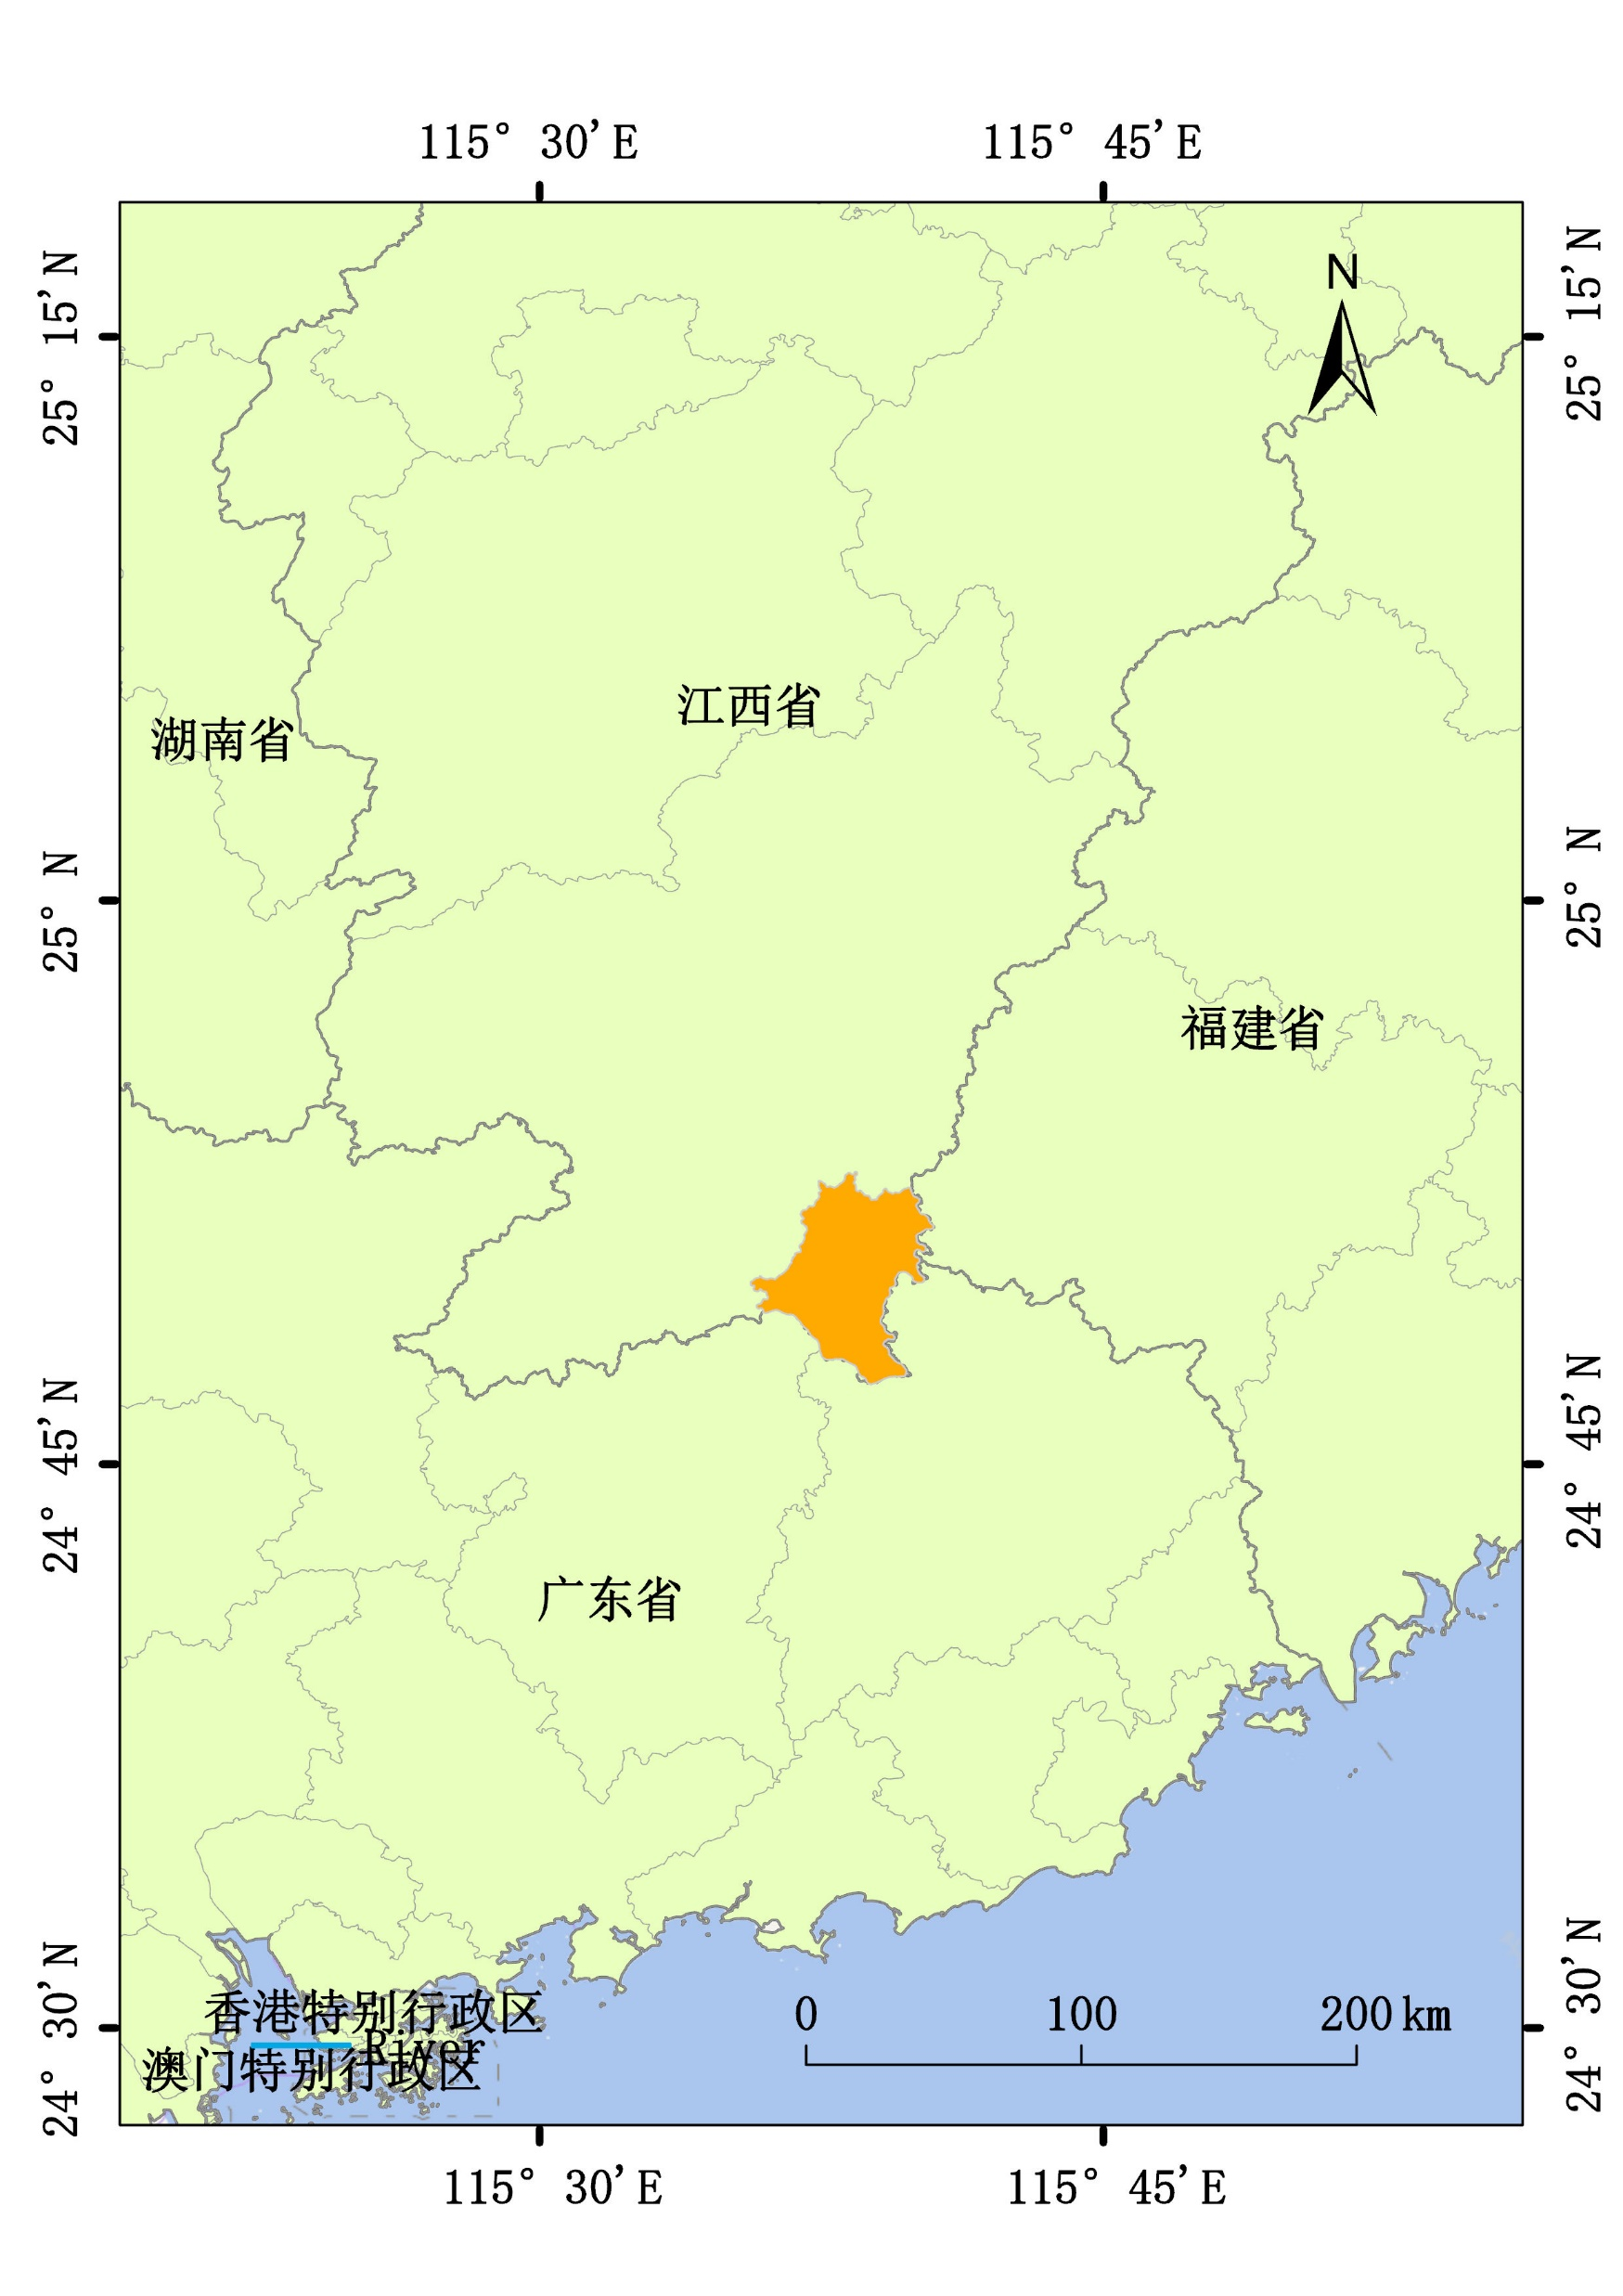
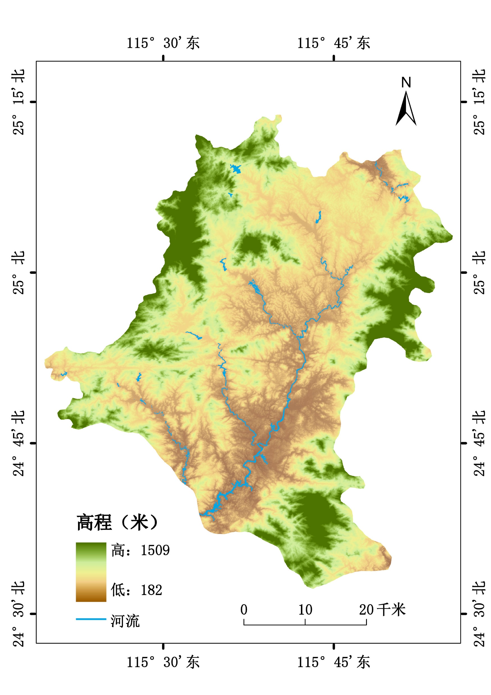
研究区域

Slide 5
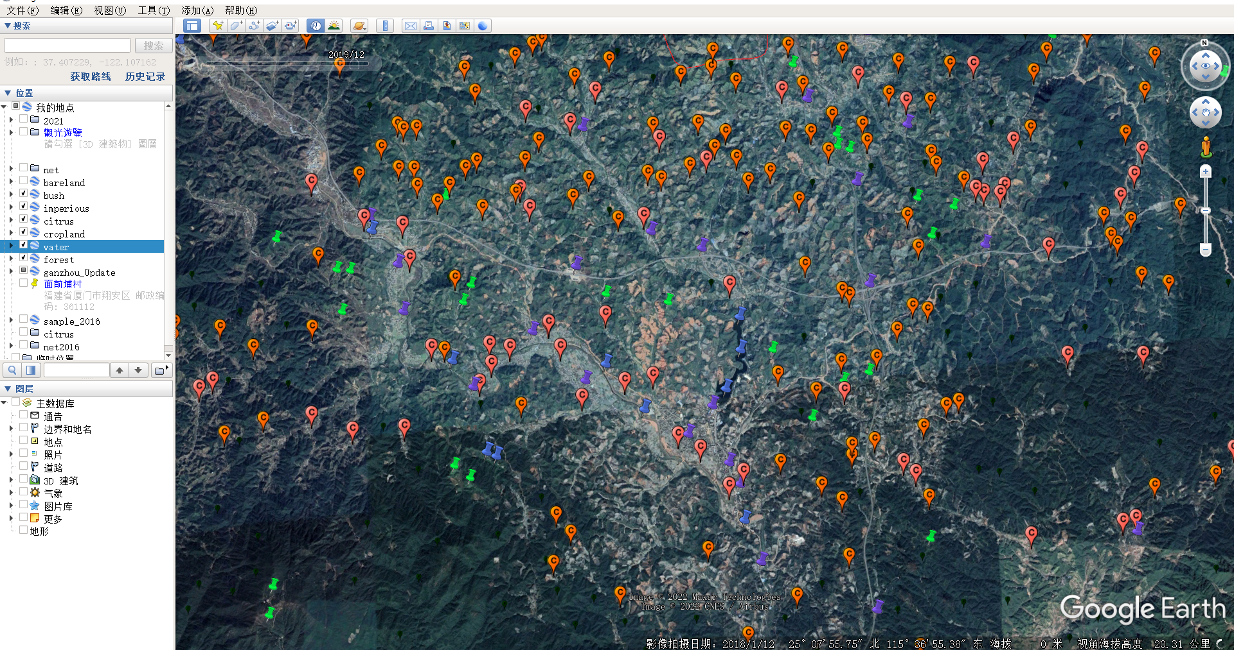
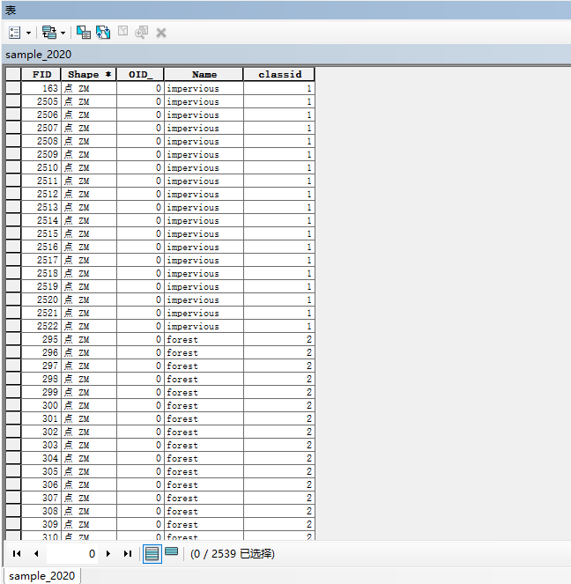
样本获取
地物类型：不透水面、水体、林地、农田、草地、裸地、柑橘、防虫网
标注原则：县域内2200-2700个为宜，均匀标注，按实际地物面积比例分配样本点个数
在Google earth pro标注样本
在ArcMap为样本赋予唯一值

Slide 6
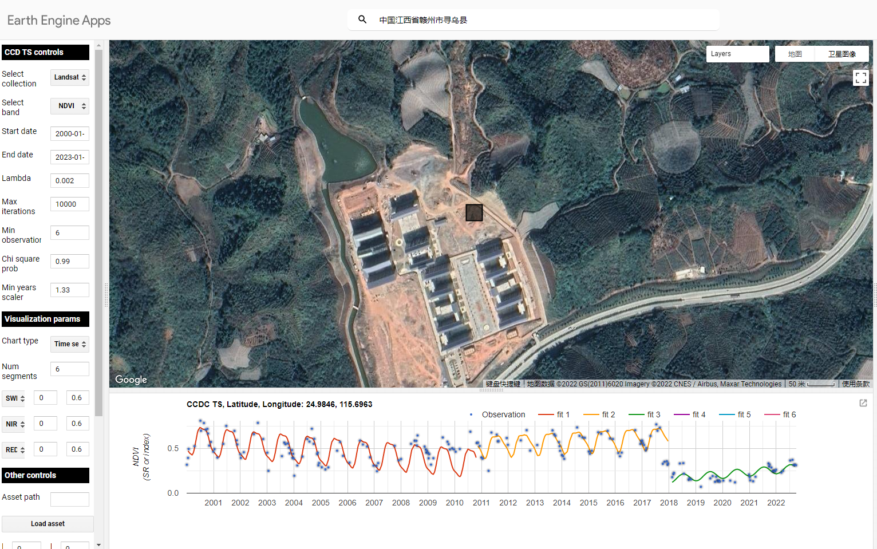
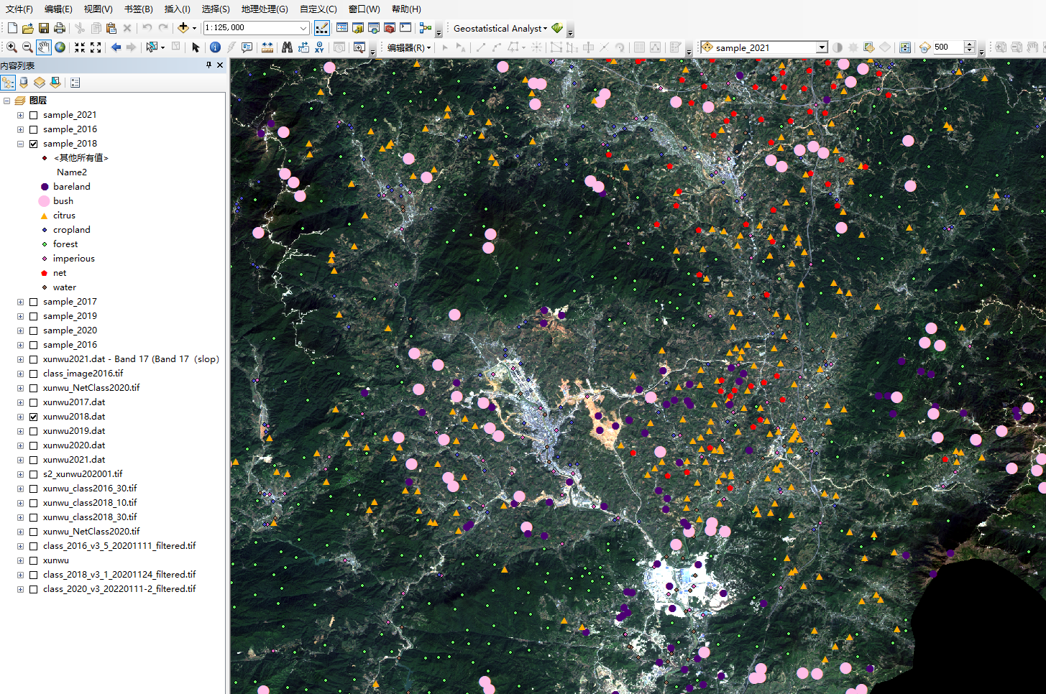
样本获取
由于Google earth上未必有目标年份的影像，可以通过前后时间的影像进行对比判断，另外使用Visualize CCD products (earthengine.app)工具辅助判读，最后下载目标年份影像进行对比查看。
使用CCD工具判断图斑变化节点
在影像上叠加样本点进行删改

Slide 7
样本获取
 | 2017 | 2018 | 2019 | 2020 | 2021 | 2022
城市 | 145 | 163 | 163 | 182 | 175 | 181
林地 | 799 | 799 | 788 | 787 | 787 | 781
水体 | 127 | 123 | 121 | 131 | 131 | 131
农田 | 384 | 409 | 409 | 463 | 452 | 452
柑橘 | 512 | 412 | 369 | 376 | 357 | 355
灌草 | 310 | 322 | 310 | 282 | 283 | 283
裸地 | 176 | 188 | 209 | 115 | 137 | 137
防虫网 | 51 | 90 | 174 | 203 | 250 | 252
总计 | 2504 | 2506 | 2543 | 2539 | 2572 | 2572

Slide 8
 | Impervious | Forest | Water | Cropland | Citrus | Bush | Bare land | IPS | Total
Number | 175 | 787 | 131 | 452 | 357 | 283 | 137 | 250 | 2572

Slide 9
分类特征获取
Sentinel-2影像光谱特征（11*4个） | 宽带指数特征组（6*4+2个） | 窄带指数特征组（7*4个） | 纹理特征组（8*4个） | SRTM30M地形-Landsat8温度特征组（1*4+4个）
B1 | NDVI | Cire | SAVG | LST
B2 | EVI | NDRE1 | VAR | elevation
B3 | SAVI | NDRE2 | CONTRAST | slope
B4 | mNDWI | MTCI | IDM | aspect
B5 | NDMI | NDVIRE1 | ENT | hillshade
B6 | PMLI | NDVIRE2 | ASM
B7 | maxNDVI | NDVIRE3 | DISS
B8 | ninNDVI |  | CORR
B9
B11
B12

Slide 10
分类特征获取

Slide 12

(a)
(b)
(c)
(d)
(e)

Slide 13
Season | Date | Sentinel-2 | Landsat-8
Winter | 2019-12-01-2020-02-28 |  | 11
 | 2020-12-01-2021-02-28 | 14 | 8
Spring | 2020-03-01-2020-05-31 | 2 | 8
 | 2021-03-01-2021-05-31 | 3 | 6
Summer | 2020-06-01-2020-08-31 | 2 | 7
 | 2021-06-01-2021-08-31 | 5 | 7
Autumn | 2020-09-01-2020-11-30 |  | 5
 | 2021-09-01-2021-11-30 | 6 | 12

Slide 14
单一特征组分类和优选
Sentinel-2影像光谱特征（44个）

Slide 15
单一特征组分类和优选
宽带指数特征组（32个）

Slide 16
单一特征组分类和优选
窄带指数特征组（28个）

Slide 17
单一特征组分类和优选
纹理特征组（32个）

Slide 18
单一特征组分类和优选
SRTM30M地形-Landsat8温度特征组（4+4个）

Slide 19
单一特征组分类和优选
光谱特征组(10个) | 宽带指数组（11个） | 窄带指数组（9个） | 纹理特征组（14个） | 地形-温度特征组（7个）
B1_4 | MNDWI_3 | MTCI_3 | SAVG_2 | elevation
B12_2 | MNDWI_2 | MTCI_2 | SAVG_1 | LST_4
B2_4 | NDVI_MIN | NDVIRE2_2 | IDM_1 | LST_1
B12_1 | MNDWI_1 | NDRE1_4 | CONTRAST_1 | LST_2
B4_4 | NDVI_MAX | NDRE2_4 | CORR_2 | LST_3
B11_4 | SAVI_4 | MTCI_4 | CONTRAST_2 | aspect
B8_4 | NDMI_1 | NDVIRE1_4 | IDM_2 | slope
B12_4 | PMLI_4 | CIRE_4 | CORR_1
B7_1 | NDVI_4 | NDVIRE1_2 | DISS_1
B7_4 | NDMI_4 |  | DISS_2
 | PMLI_1 |  | VAR_2
 |  |  | VAR_1
 |  |  | ASM_2
 |  |  | SAVG_3

Slide 20
Feature type | Band name | Number of bands
Spectral bands | B1_4，B12_2，B2_4，B12_1，B4_4，B11_4，B8_4， B12_4，B7_1，B7_4 | 10
Conventional spectral index | MNDWI_3，MNDWI_2，NDVI_MIN，MNDWI_1，NDVI_MAX，SAVI_4，NDMI_1，PMLI_4，NDVI_4，NDMI_4，PMLI_1 | 11
Red-edge index | MTCI_3，MTCI_2，NDVIRE2_2，NDRE1_4，NDRE2_4，MTCI_4，NDVIRE1_4，CIRE_4，NDVIRE1_2 | 9
Textural features | SAVG_2，SAVG_1，IDM_1，CON_1，CORR_2，CON_2，IDM_2，CORR_1，DISS_1，DISS_2， VAR_2，VAR_1，ASM_2，SAVG_3 | 14
Topographic-temperature features | Elevation，LST_4，LST_1，LST_2，LST_3，Aspect，Alope | 7

Slide 21
单一特征组分类和优选
spring | summer | fall | winter | other | all
12 | 13 | 4 | 19 | 3 | 51
0.235294118 | 0.254901961 | 0.078431373 | 0.37254902 | 0.058823529 | 1

Slide 28
season | spring | summer | fall | winter | other
Number of bands | 12 | 13 | 4 | 19 | 3
percentage | 23.53% | 25.49% | 7.84% | 37.25% | 5.88%

Slide 29
Sentinel-2
Sentinel-2
Landsat-8
数据获取
Google earth engine
去云处理
季节性合成
重采样
影像裁剪
去云处理
季节性合成
地温反演
重采样
影像裁剪
Landsat-8
SRTM3.0
季节性光谱特征 | B1 | B7
 | B2 | B8
 | B3 | B9
 | B4 | B11
 | B5 | B12
 | B6
常规指数特征 | NDVI
 | EVI
 | SAVI
 | MNDWI
 | NDMI
 | PMLI
 | NDVImax
 | NDVImin
红边指数特征 | CIre
 | NDre1
 | NDre2
 | MTCI
 | NDVIre1
 | NDVIre1
 | NDVIre1
纹理特征 | SAVG
 | VAR
 | IDM
 | CON
 | DISS
 | ENT
 | ASM
 | CORR
地形- 温度特征 | DEM
 | SLOPE
 | Aspect
 | Hill shade
 | LST
5类特征组
特征变量获取
单一特征输入
随机森林分类
输出重要性排序
特征递归消除
输出精度变化曲线
特征优选
获得最优特征组合
随机森林分类
穷举法组合特征
5组筛选后的特征
截取单一特征最优特征维数

Slide 30
Sentinel-2 MSI (2021)
Image filtering (cloud cover <20%)
Seasonal composition
Seasonal images
Feature extraction
Spectral bands
Landsat-8 TIRS (2021)
Image filtering (cloud cover <50%)
Statistical Mono-Window (SMW) algorithm
Land surface temperature (LST)
Seasonal composition
Conventional spectral index
SRTM digital elevation
Feature extraction
Topographical features
Seasonal LST features
Red-edge index
Textural features
Topographic-temperature features

Slide 31
单一特征组分类和优选
4+6+4+1
num | Feature category | number of bands | OA | kappa | UA(citrus) | PA(citrus) | UA(net) | PA(net)
1 | 多时相光谱 | 10 | 86.79% | 84.15% | 86.81% | 84.04% | 77.92% | 69.77%
2 | 中值合成影像 | 11 | 83.74% | 83.49% | 78.38% | 76.99% | 88.06% | 66.29%
3 | 宽带指数特征 | 11 | 83.27% | 79.64% | 82.41% | 82.41% | 70.51% | 82.41%
4 | 窄带指数特征 | 9 | 78.47% | 73.70% | 68.27% | 62.07% | 60.56% | 56.41%
5 | 地形温度特征 | 7 | 57.99% | 48.46% | 44.39% | 42.38% | 48.02% | 45.36%
6 | 纹理特征 | 14 | 56.16% | 45.77% | 46.34% | 41.75% | 46.56% | 42.68%

Slide 32
4+6+3+1
Rank | Feature type | Number of bands | OA | Kappa | UA(Citrus) | PA(Citrus) | UA(IPS) | PA(IPS)
1 | Spectral bands | 10 | 86.79% | 84.15% | 86.81% | 84.04% | 77.92% | 69.77%
2 | Spectral bands（Non-seasonal） | 11 | 83.74% | 83.49% | 78.38% | 76.99% | 88.06% | 66.29%
3 | Conventional spectral index | 11 | 83.27% | 79.64% | 82.41% | 82.41% | 70.51% | 82.41%
4 | Red-edge index | 9 | 78.47% | 73.70% | 68.27% | 62.07% | 60.56% | 56.41%
5 | Topographic-temperature features | 7 | 57.99% | 48.46% | 44.39% | 42.38% | 48.02% | 45.36%
6 | Textural features | 14 | 56.16% | 45.77% | 46.34% | 41.75% | 46.56% | 42.68%

Slide 33
Rank | Feature combination | Number of bands | OA | Kappa | UA(Citrus) | PA(Citrus) | UA(IPS) | PA(IPS)
1 | Spectral bands + Conventional spectral index + Topographic-temperature features | 28 | 91.85% | 90.17% | 85.25% | 92.86% | 85.25% | 87.84%
2 | Spectral bands + Textural features + Topographic-temperature features | 31 | 91.34% | 89.47% | 85.19% | 90.91% | 91.67% | 84.85%
3 | Spectral bands + Conventional spectral index + Red-edge index + Topographic-temperature features | 37 | 91.31% | 89.36% | 86.67% | 91.00% | 91.03% | 87.65%
4 | Spectral bands + Conventional spectral index + Red-edge index + Textural features + Topographic-temperature features | 51 | 91.21% | 87.56% | 85.32% | 88.29% | 87.10% | 84.48%
5 | Spectral bands + Conventional spectral index + Textural features + Topographic-temperature features | 42 | 90.15% | 89.66% | 85.16% | 90.83% | 92.00% | 84.15%
6 | Spectral bands + Red-edge index + Textural features + Topographic-temperature features | 40 | 90.09% | 87.94% | 90.52% | 85.37% | 94.59% | 82.35%
7 | Spectral bands + Topographic-temperature features | 17 | 90.09% | 84.80% | 82.12% | 87.86% | 87.67% | 87.71%
8 | Spectral bands + Red-edge index + Topographic-temperature features | 26 | 89.49% | 88.08% | 87.62% | 95.83% | 88.31% | 81.93%
9 | Spectral bands + Conventional spectral index + Red-edge index + Textural features | 44 | 88.62% | 88.74% | 86.73% | 87.04% | 80.56% | 95.95%
10 | Spectral bands + Conventional spectral index | 21 | 88.27% | 85.80% | 94.17% | 84.79% | 81.08% | 79.12%
11 | Spectral bands + Conventional spectral index+ Red-edge index | 30 | 87.96% | 85.54% | 89.52% | 83.93% | 77.78% | 84.00%
12 | Spectral bands + Textural features | 24 | 87.34% | 84.21% | 86.92% | 86.27% | 77.38% | 71.43%
13 | Spectral bands + Red-edge index + Textural features | 33 | 87.24% | 84.47% | 82.35% | 85.96% | 74.39% | 85.92%
14 | Spectral bands + Conventional spectral index + Textural features | 35 | 87.22% | 87.05% | 87.25% | 89.19% | 81.54% | 80.00%
15 | Spectral bands + Red-edge index | 19 | 86.83% | 84.64% | 88.18% | 88.81% | 76.71% | 74.60%

Slide 35
Sentinel-2 MSI (2021)
Landsat-8 TIRS (2021)
SRTM digital elevation
5 Groups of features
Image filtering (cloud cover <20%)
Image filtering (cloud cover <50%)
Feature extraction
Recursive feature elimination (RFE)
Seasonal composition
Statistical Mono-Window (SMW) algorithm
Topographical features
Select the best feature group
Seasonal images
Land surface temperature (LST)
Combining other features
Feature extraction
Seasonal composition
15 Feature Combinations
Seasonal LST features
Combination
Random Forest Classification
Spectral bands, Conventional spectral index
Red-edge index, Texture
Topographic-temperature features
Select the best Classification scheme

Slide 36
Sentinel-2 MSI (2021)
Landsat-8 TIRS (2021)
SRTM digital elevation
Feature extraction
Spectral bands, Conventional spectral index
Red-edge index, Texture, Topographic-temperature
Recursive feature elimination (RFE)
Select the best feature group
Combining other features
15 Feature Combinations
Random Forest Classification
Select the best Classification scheme

Slide 37
Code | Combination scheme | Number of bands
C1 | Spectral bands + Topographic-temperature | 17
C2 | Spectral bands + Red-edge index | 19
C3 | Spectral bands + Conventional spectral index | 21
C4 | Spectral bands + Textural | 24
C5 | Spectral bands + Red-edge index + Topographic-temperature | 26
C6 | Spectral bands + Conventional spectral index + Topographic-temperature | 28
C7 | Spectral bands + Conventional spectral index + Red-edge index | 30
C8 | Spectral bands + Topographic-temperature + Textural | 31
C9 | Spectral bands + Red-edge index + Textural | 33
C10 | Spectral bands + Conventional spectral index + Textural | 35
C11 | Spectral bands + Conventional spectral index + Red-edge index + Topographic-temperature | 37
C12 | Spectral bands + Red-edge index + Topographic-temperature + Textural | 40
C13 | Spectral bands + Conventional spectral index + Topographic-temperature + Textural | 42
C14 | Spectral bands + Conventional spectral index + Red-edge index + Textural | 44
C15 | Spectral bands + Conventional spectral index + Red-edge index + Topographic-temperature + Textural | 51

Slide 38
组合特征组分类和优选
num | Feature combination | number of bands | OA | kappa | UA(citrus) | PA(citrus) | UA(net) | PA(net)
1 | 多时相光谱+宽带指数特征组+地形温度特征组 | 28 | 91.85% | 90.17% | 85.25% | 92.86% | 85.25% | 87.84%
2 | 多时相光谱+纹理特征组+地形温度特征组 | 31 | 91.34% | 89.47% | 85.19% | 90.91% | 91.67% | 84.85%
3 | 多时相光谱+宽带指数特征组+窄带指数特征组+地形温度特征组 | 37 | 91.31% | 89.36% | 86.67% | 91.00% | 91.03% | 87.65%
4 | 多时相光谱+宽带指数特征组+窄带指数特征组+纹理特征组+地形温度特征组 | 51 | 91.21% | 87.56% | 85.32% | 88.29% | 87.10% | 84.48%
5 | 多时相光谱+地形温度特征组 | 17 | 90.09% | 84.80% | 79.00% | 91.86% | 87.67% | 87.67%
6 | 多时相光谱+宽带指数特征组 | 21 | 88.27% | 85.80% | 94.17% | 79.79% | 81.08% | 81.08%
7 | 多时相光谱+宽带指数特征组+窄带指数特征组 | 30 | 87.96% | 85.54% | 89.52% | 83.93% | 77.78% | 84.00%
8 | 多时相光谱+纹理特征组 | 24 | 87.34% | 84.21% | 86.92% | 86.27% | 77.38% | 71.43%
9 | 多时相光谱+纹理特征组+窄带指数特征组 | 33 | 87.24% | 84.47% | 82.35% | 85.96% | 74.39% | 85.92%
10 | 多时相光谱+窄带指数特征组 | 19 | 86.43% | 83.64% | 88.18% | 88.81% | 75.71% | 72.60%

Slide 39
